Slide 1
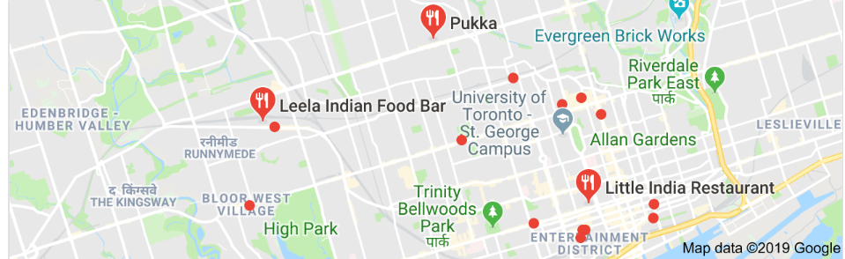
Battle of Neighbourhood
Analysis of Indian Restaurants in Toronto

Slide 2
Introduction
Toronto a city with a diverse ethnicity. Toronto has an estimated population of just over 2.8 million in 2016, which makes it the 4th most populous city in North America and the most populous Great Lakes city. Toronto, which is located on Lake Ontario, is the most populous city in Canada and the provincial capital of Ontario.
So as part of this project, we will list and visualize all major parts of Toronto that has great Indian restaurants.
Question to be answered
What is best location in Toronto for Indian Cuisine?
Which areas have potential Indian Restaurant Market?
Which all areas lack Indian Restaurants?
Which is the best place to stay if I prefer Indian Cuisine?

Slide 3
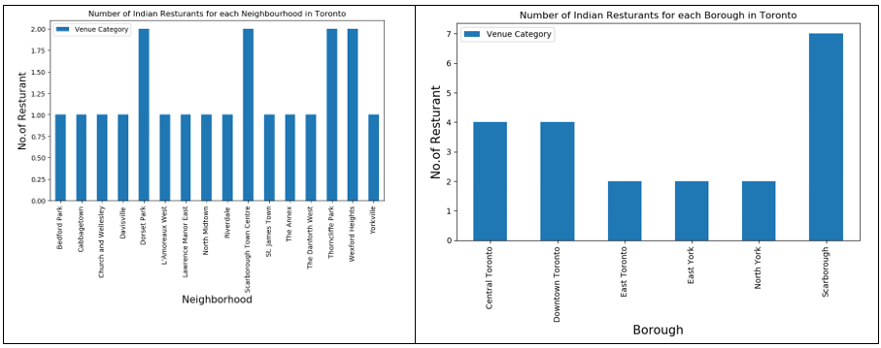
Data Collection and Analysis
Toronto Boroughs, Neighbourhoods along with the postal codes are collected form the Wikipedia page. Then these postal codes are mapped with the details present in the CSV files (http://cocl.us/Geospatial_data) to get the required coordinates.
Indian Restaurant details

Slide 4
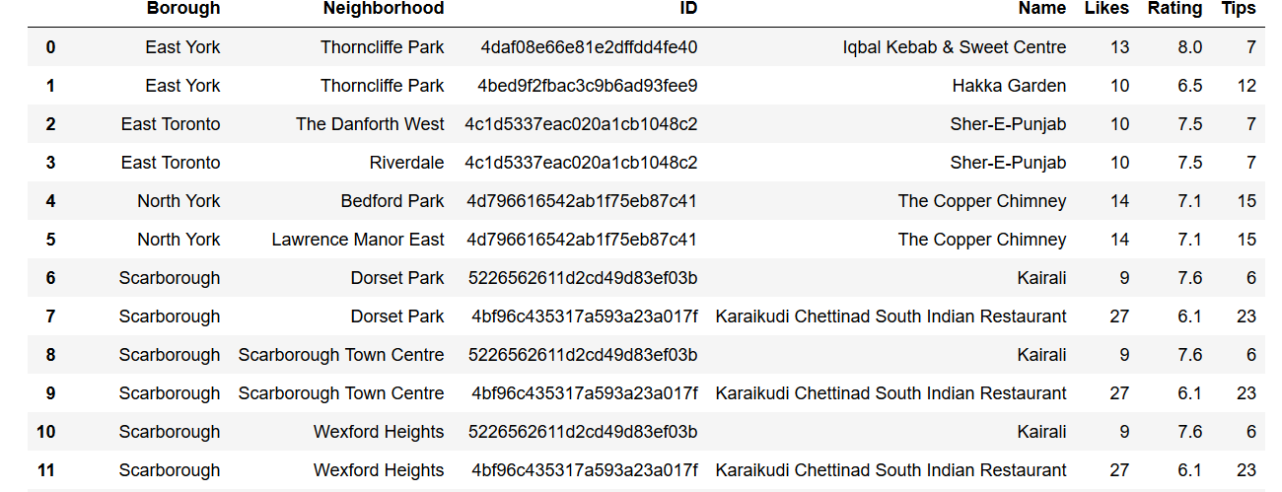
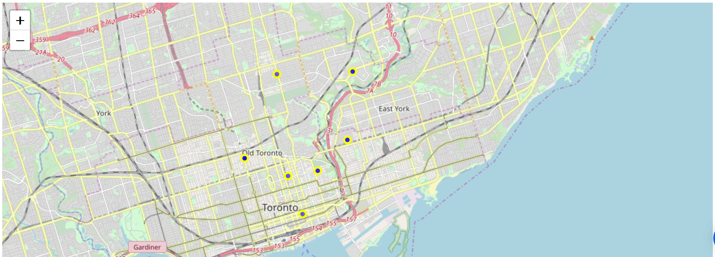
Data Collection and Analysis
Venue details are derived from Foursquare API. Indian Restaurants are then filtered out for analysis.

Slide 5
Conclusion
Below is the final conclusion of the analysis:
Etobicoke has the maximum number of neighbourhoods. Etobicoke does not have an Indian Restaurant.
North York has 2 Indian Restaurant with the lowest rating. North York are potential Borough to open new good Indian Restaurant
Scarborough has 6 Indian Restaurant. It is the best place to stay if you prefer Indian Cuisine.
Central Toronto and Downtown Toronto has good restaurants. These places need to be visited for good food.

